Slide 1

Cognitive Psychology
WEEK 3
BY: AQSA FAYYAZ
LECTURER Psychology
(SCIENCE AND HUMANITIES)

Slide 2
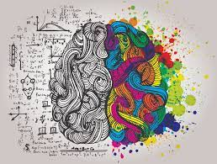
Cognition
The word ‘cognition’ is derived from the Latin word cognoscere, meaning “to know” or “to come to know”.
In other words, it might include the processes that help us to perceive, attend, remember, think, categorize, reason, decide, and so on.

Slide 3

Cognitive Psychology
Cognitive psychology, as the name suggests, is that branch of psychology that deals with cognitive mental processes. “Cognitive psychology is an area that focuses on the science of how people think.”
Sternberg (1999) defined Cognitive psychology as that which deals with “how people perceive, learn, remember, and think about information.”
In 2005, Solso gave another definition of Cognitive psychology as the study of processes underlying mental events.
In general, Cognitive psychology can thus be defined as that branch of psychology that is concerned with how people acquire, store, transform, use and communicate language.

Slide 4
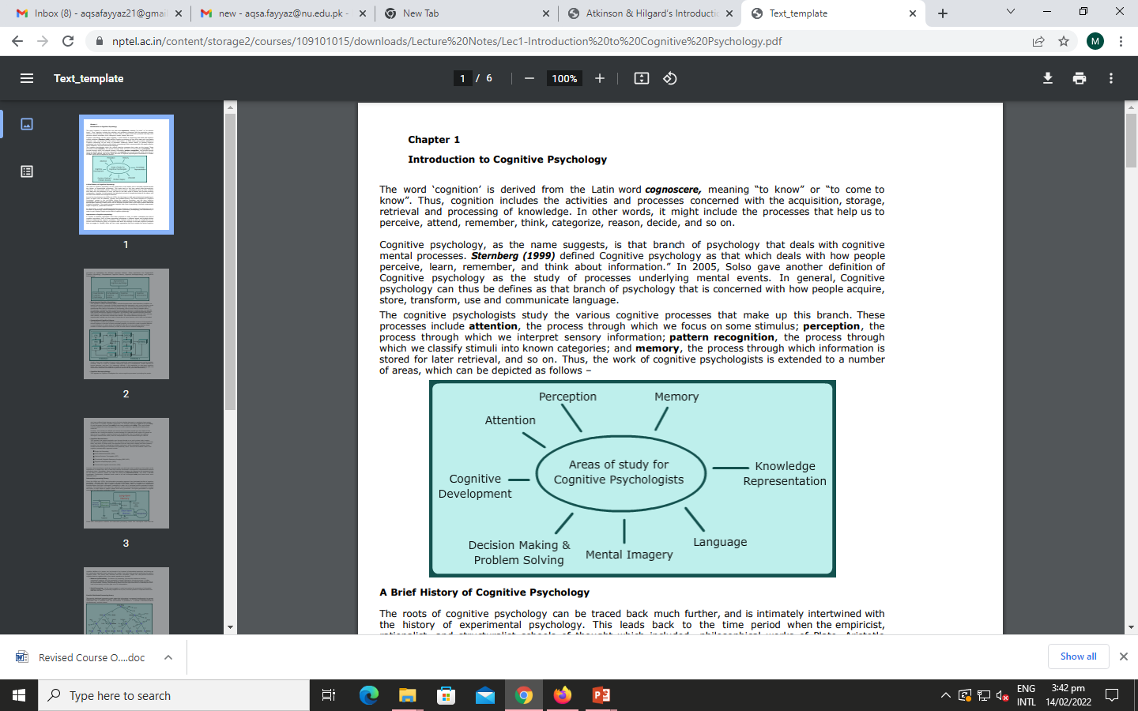
The cognitive psychologists study the various cognitive processes that make up this branch.
These processes include attention, the process through which we focus on some stimulus; perception, the process through which we interpret sensory information; pattern recognition, the process through which we classify stimuli into known categories; and memory, the process through which information is stored for later retrieval, and so on.
The study of higher mental processes such as attention, language use, memory, perception, problem solving, and thinking.

Slide 5

History of Cognitive Psychology
Cognitive psychology became more predominant during the period between the 1950s and 1970s. Prior to this time, behaviorism was the dominant perspective in psychology, but researchers began to grow more interested in the internal processes that affect behavior instead of just the behavior itself.
Cognitive revolution in psychology.
In 1967, the psychologist Ulric Neisser introduced the term cognitive psychology, which he defined as the study of the processes behind the perception, transformation, storage, and recovery of information.

Slide 6

Types of Cognitive Processes
There are many different types of cognitive processes. These include:
Attention: Attention is a cognitive process that allows people to focus on a specific stimulus in the environment.
Language: Language and language development are cognitive processes that involve the ability to understand and express thoughts through spoken and written words. It allows us to communicate with others and plays an important role in thought.
Learning: requires cognitive processes involved in taking in new things, synthesizing information, and integrating it with prior knowledge.

Slide 7
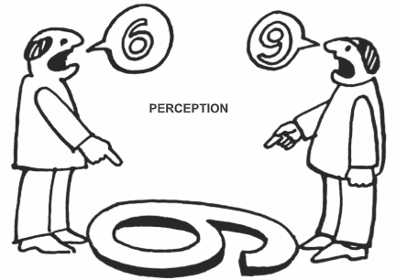
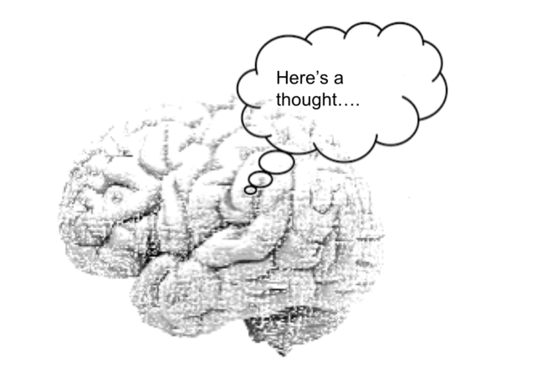
Memory: Memory is an important cognitive process that allows people to encode, store, and retrieve information. It is a critical component in the learning process and allows people to retain knowledge about the world and their personal histories.
Perception: Perception is a cognitive process that allows people to take in information through their senses (sensation) and then utilize this information to respond and interact with the world.
Thought: Thought is an essential part of every cognitive process. It allows people to engage in decision-making, problem-solving, and higher reasoning.

Slide 8
Mediational Processes
The behaviorists approach only studies external observable (stimulus and response) behavior which can be objectively measured.
They believe that internal behavior cannot be studied because we cannot see what happens in a person’s mind (and therefore cannot objectively measure it).
In comparison, the cognitive approach believes that internal mental behavior can be scientifically studied using experiments.
Cognitive psychology assumes that a mediational process occurs between stimulus/input and response/output.

Slide 9
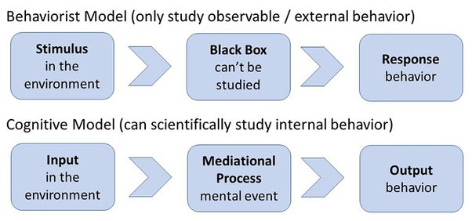
The mediational (i.e. mental) event could be memory, perception, attention or problem solving etc. These are known as mediational processes because they mediate (i.e. go-between) between the stimulus and the response.
They come after the stimulus and before the response. Therefore, cognitive psychologists’ say if you want to understand behavior, you have to understand these mediational processes.

Slide 10
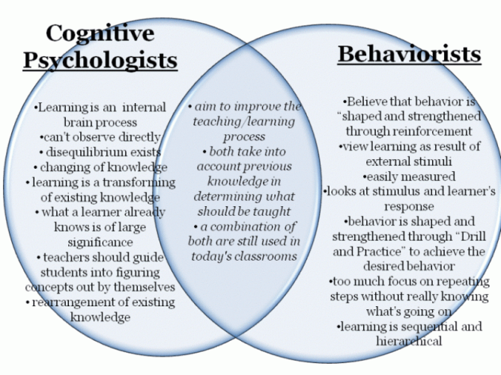

Slide 11
Three important Cognitive Psychology Theories
Piaget's theory of cognitive development
Lev Vygotsky's social cultural cognitive theory,
The information process theory.

Slide 12
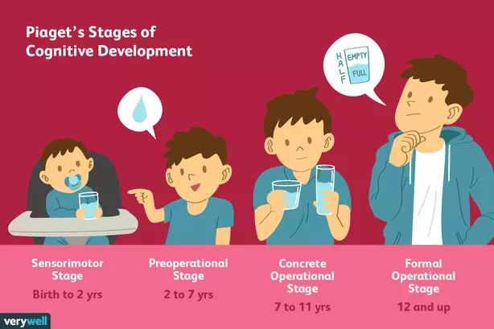
Piaget's theory of cognitive development

Slide 13
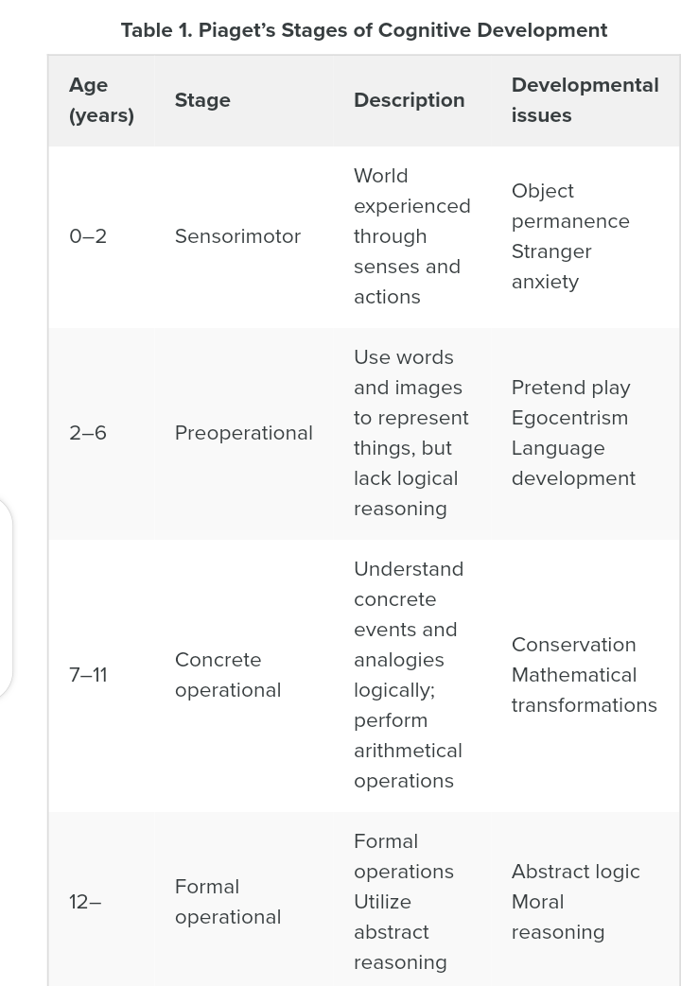

Slide 14


1.The Sensorimotor Stage
Ages: Birth to 2 Years
The infant knows the world through their movements and sensations
Children learn about the world through basic actions such as sucking, grasping, looking, and listening
With time Infants learn that things continue to exist even though they cannot be seen (object permanence)
They learn that they are separate beings from the people and objects around them.
They realize that their actions can cause things to happen in the world around them

Slide 15

2.The Preoperational Stage
Ages: 2 to 7 Years
Children begin to think symbolically and learn to use words and pictures to represent objects.
Children at this stage tend to be egocentric and struggle to see things from the perspective of others.
While they are getting better with language and thinking, they still tend to think about things in very concrete terms.

Slide 16
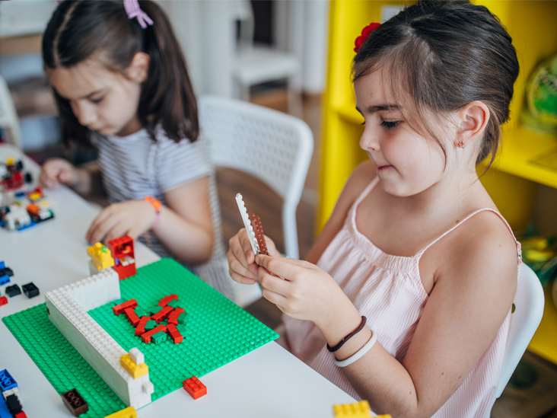
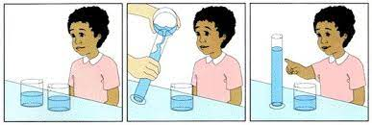
3.The Concrete Operational Stage
Ages: 7 to 11 Years
During this stage, children begin to thinking logically about concrete events
They begin to understand the concept of Conservation which is the understanding that something stays the same in quantity even though its appearance changes
; for example: that the amount of liquid in a short, wide cup is equal to that in a tall, skinny glass,.
Their thinking becomes more logical and organized, but still very concrete
Children begin using inductive logic, or reasoning from specific information to a general principle.

Slide 17
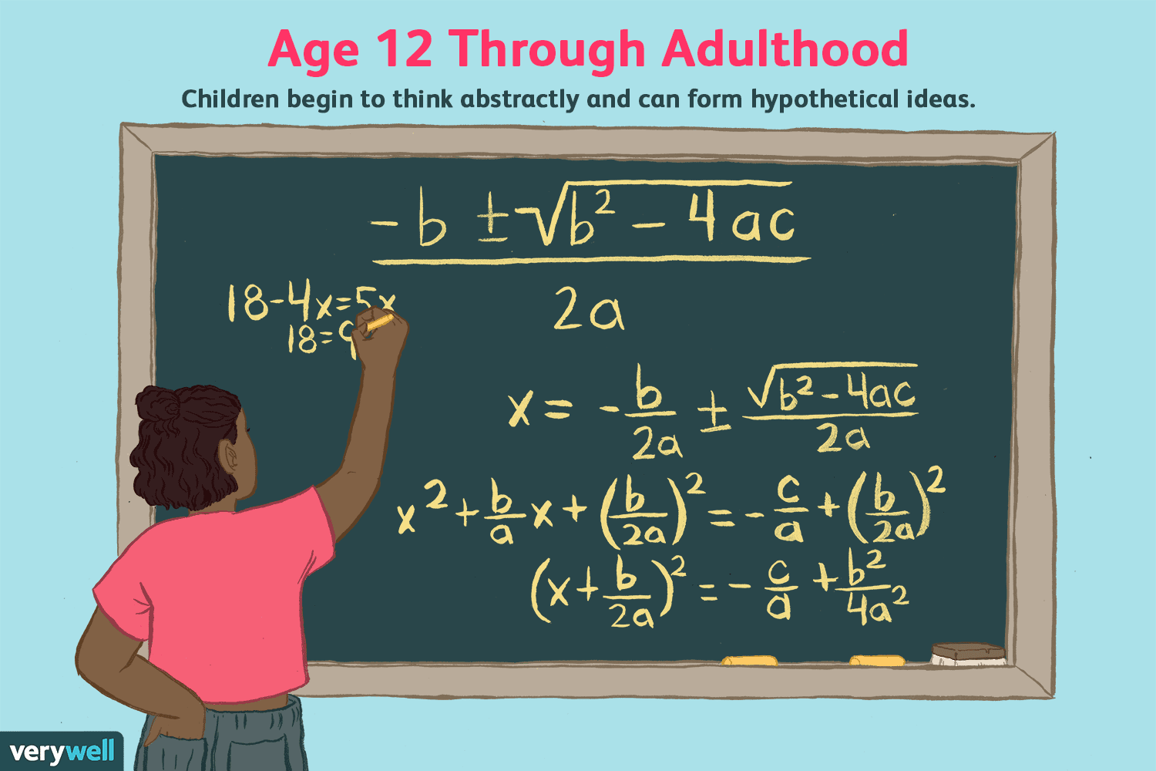
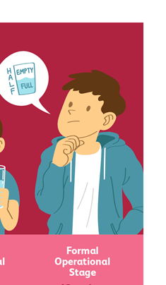
4.The Formal operational stage
Ages: 12 and Up
Major Characteristics and Developmental Changes:
At this stage, the adolescent or young adult begins to think abstractly and reason about hypothetical problems
Abstract thought emerges
Teens begin to think more about moral, philosophical, ethical, social, and political issues that require theoretical and abstract reasoning
Begin to use deductive logic, or reasoning from a general principle to specific information

Slide 18
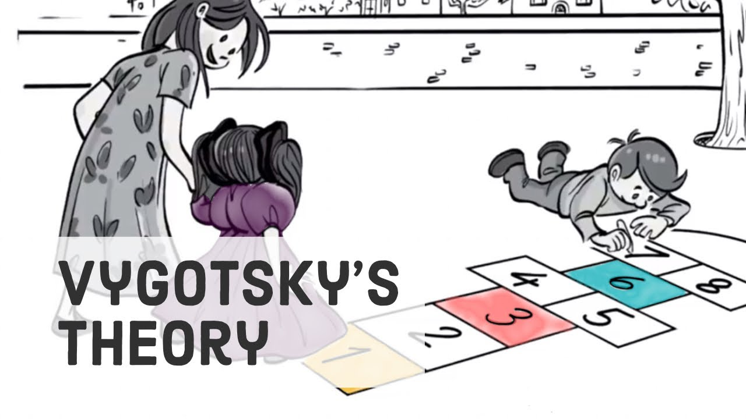
Lev Vygotsky's Social Cultural Cognitive Theory
Vygotsky's theory revolves around the idea that social interaction is central to learning.
Vygotsky's sociocultural theory asserts that learning is an essentially social process in which the support of parents, caregivers, peers and the wider society and culture plays a crucial role in the development of higher psychological functions.

Slide 19
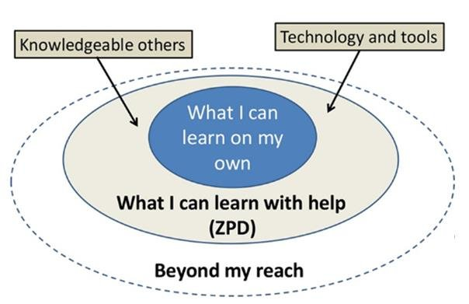
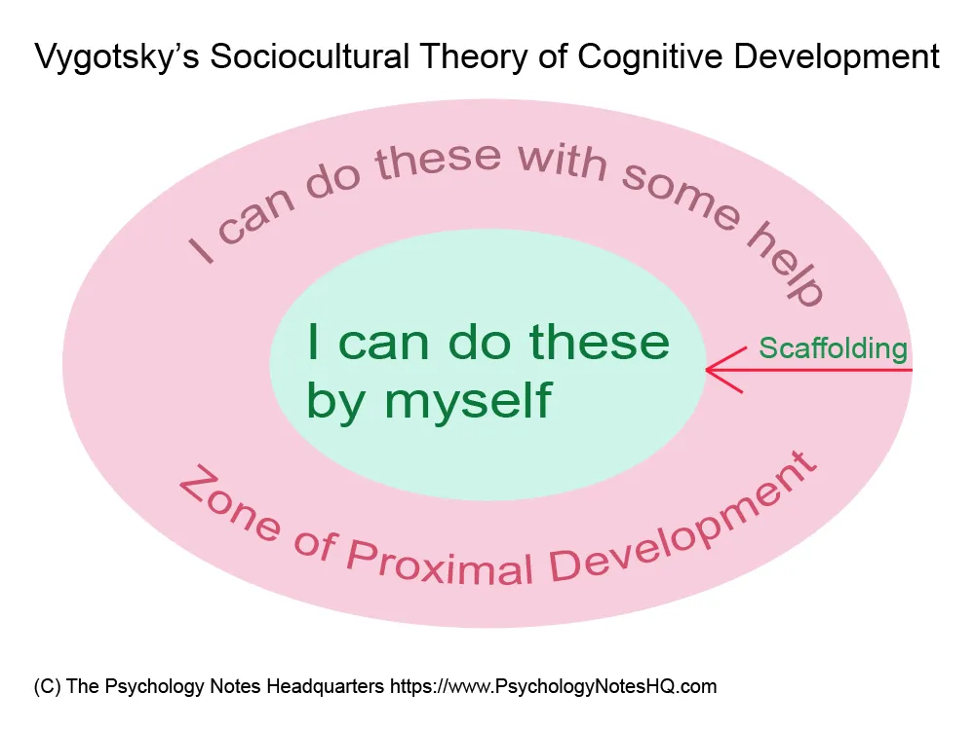
Vygotsky’s concept of Zone of Proximal Development
Vygotsky’s concept of Zone of Proximal Development underscores Vygotsky’s conviction that social influences, particularly getting instructions from someone are of immense importance on the cognitive development in early childhood.

Slide 20
Vygotsky’s concept of Zone of Proximal Development
The Zone of Proximal Development is defined as the space between what a learner can do without assistance and what a learner can do with adult guidance or in collaboration with more capable peers

Slide 21


For example, a five-year-old child knows how to ride a tricycle, but can’t ride a bicycle (with two wheels) unless his grandfather holds onto the back of her bike. According to Vygotsky’s theory, this child is in the zone of proximal development for riding bicycle.
With her grandfather’s help, this little girl learns to balance her bike. After some practicing, she can ride the bike on her own.

Slide 22
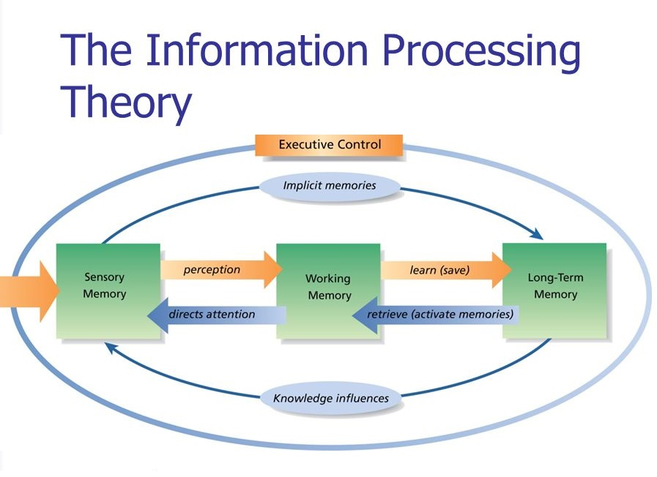
Information Processing Theory
It is a cognitive theory that focuses on how information is encoded into our memory. The theory describes how our brains filter information, from what we’re paying attention to in the present moment, to what gets stored in our short-term or working memory and ultimately into our long-term memory.

Slide 23
Research Methods in Cognitive Psychology
Individual experiments and psychobiological studies often focus on precise specification of discrete aspects of cognition across individuals. To obtain richly textured information about how particular individuals think in a broad range of contexts, researchers may use other methods. These methods include:
self-reports (an individual’s own account of cognitive processes);
case studies (in-depth studies of individuals); and
Naturalistic observation (detailed studies of cognitive performance in everyday situations and nonlaboratory contexts).

Slide 24
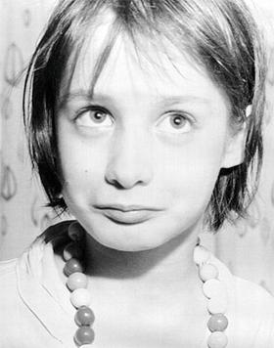
A case study Genie (feral child)
Genie (born 1957) is the pseudonym of an American feral child who was a victim of severe abuse, neglect, and social isolation.
When she was approximately 20 months old, her father began keeping her in a locked room.
During this period, he almost always strapped her into a child's toilet or bound her in a crib with her arms and legs immobilized, forbade anyone from interacting with her, provided her with almost no stimulation of any kind, and left her severely malnourished.

Slide 25
What have we learned from Genie Wiley?
Genie's story suggests that the acquisition of language has a critical period of development. Her case is complex, however, since it is unclear if her language deficits were due to deprivation or if there was an underlying mental disability that played a role. The severe abuse she experienced may have also affected her mental development and language acquisition.

Slide 26
Cognitive Psychology
Decision Making
Problem Solving

Slide 27

Decision Making

Slide 28


Slide 29
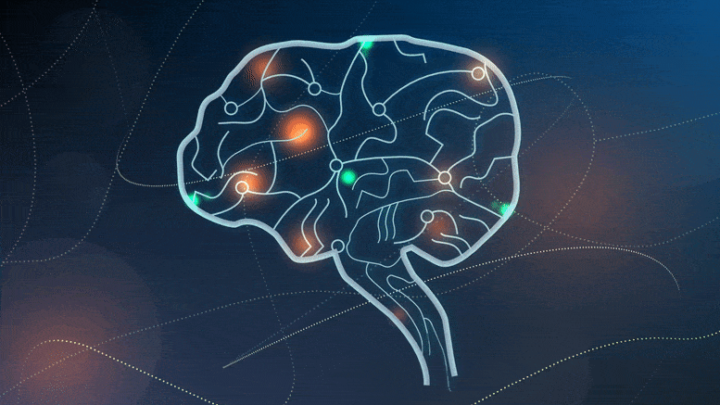
In psychology, decision-making is regarded as the cognitive process resulting in the selection of a belief or a course of action among several possible alternative options, it could be either rational or irrational. The cognitive process of choosing between two or more alternatives, ranging from the relatively clear cut (e.g., ordering a meal at a restaurant) to the complex (e.g., selecting a mate)

Slide 30

Some decisions are easy like
What to eat in breakfast?

Slide 31

What to wear today?

Slide 32

Some decisions are difficult like…
Choosing a career?

Slide 33

Choosing a life partner?

Slide 34

In every situation you have to search for….

Slide 35

How to make right decision?????

Slide 36
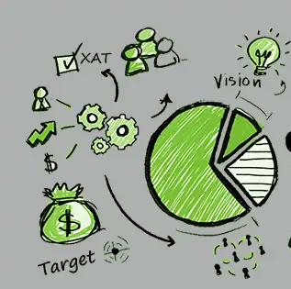
Decision making strategies
The Single-Feature Model:
making a decision based on only a single feature or criteria.
For example, imagine that you are buying soap. Faced with a wide variety of options at your local superstore, you decide to base your decision on price and buy the cheapest type of soap available. In this case, you ignored other variables (such as scent, brand, reputation, and effectiveness) and focused on just a single feature i.e. the price.

Slide 37
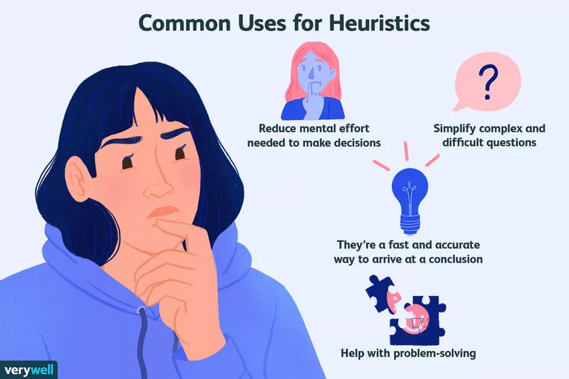
Heuristic
A heuristic is a mental shortcut that allows people to solve problems and make judgments quickly and efficiently. It involves making judgments by comparing things to concepts we already have in mind.
These rule-of-thumb strategies shorten decision-making time and allow people to function without constantly stopping to think about their next course of action.

Slide 38
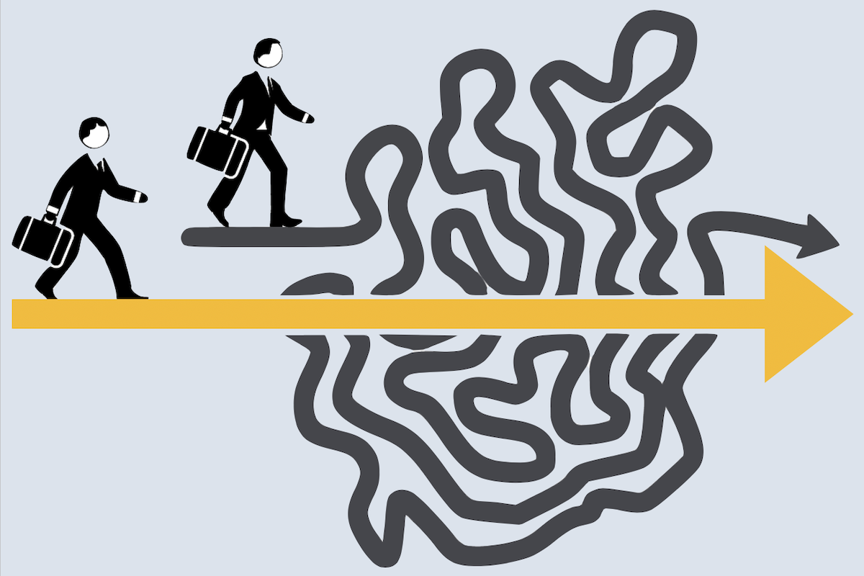
Types of Heuristic
1. The Availability Heuristic
When we are trying to determine how likely something is, we often base such estimates on how easily we can remember similar events happening in the past.
Easily accessible information can be:
Information that you memorized more easily
Something that affected you strongly or had a bigger impact on you
Events that happened more recently in your memory
The availability heuristic is based on ease of retrieval. The easier something is to recall, the more likely you are to use it to form your beliefs and opinions.

Slide 39
EXAMPLES
Excessive coverage on the news or social media about plane crashes uses vivid images and stories to elicit an emotional response. Availability bias makes those images easily accessible, causing an irrational fear of flying.
Guessing which university in your state more people will attend based on your inner circle and their school preferences

Slide 40
II. The Representativeness Heuristic
making a judgment about the likelihood of an event or fact based on preconceived notions or memories of a prototype, stereotype or average
The representativeness heuristic is a mental shortcut that we use when estimating probabilities. When we’re trying to assess how likely a certain event is, we often make our decision by assessing how similar it is to an existing mental prototype.
EXAMPLE:
Assuming someone is arrogant and self-absorbed because they are reserved, quiet and rarely interact with people.
Guessing that someone who is creative, quirky and dressed colorfully is a humanities major.

Slide 41
Problem solving

Slide 42
Definition
In cognitive psychology, the term problem-solving refers to the mental process that people go through to discover, analyze, and solve problems.
A systematic approach to defining the problem (question or situation that presents uncertainty, perplexity or difficulty) and creating a vast number of possible solutions without judging these solutions.

Slide 43

What is PROBLEM???
In the context of cognitive psychology, a problem is any situation in which we are trying to reach a goal and we must find a means to reach that goal.

Slide 44
Decision-making: The act of narrowing down the possibilities, choosing a course of action, and determining the action’s potential consequences.

Slide 45
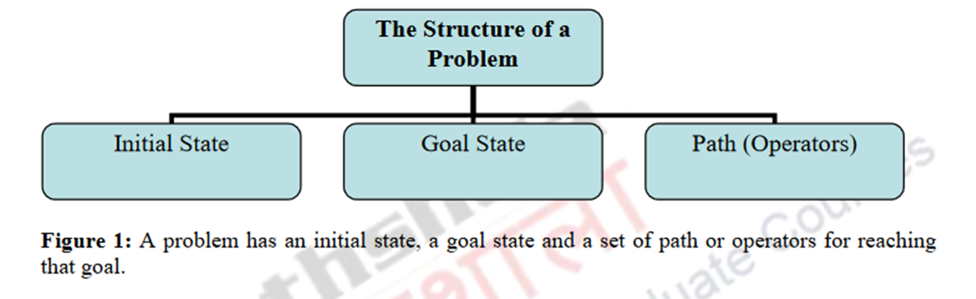
The Structure of a Problem

Slide 46
What will you eat and how will you obtain your food?
To decide what you will eat you will have to weigh endless options-whether to cook at home or bring cooked food from outside home, if cooking at home then what resources and materials are available and what and how much can be cooked from it.
Likewise, if food is ordered from outside what can be ordered and how much. You are also likely to weigh the financial aspect and a number of other aspects(such as choice of cuisine, location etc.) while solving the problem of what will you eat.

Slide 47
STRUCTURE:
Solving a problem entails
the goal (to eat something) and the numerous paths that might be undertaken to reach the goal (from where and what to procure for eating).
Each path includes numerous sub-steps and sub-goals that fit together to meet the larger goal.
Thus, putting it in very simple terms, every problem has an initial stage or a current situation that helps define and delimit the nature of the problem; a desired outcome or the goal that needs to be achieved through a series of steps; and a path for reaching that goal.

Slide 48
Classes of Problems
Problems can be classified into two categories-well-defined problems and Ill-defined problems.
Well-Defined Problems: In a well defined problem, the initial state, the goal state and one or more paths or operators to obtain that goal are clearly stated.
Your car doesn’t start in the morning and you want to try and find out what’s wrong with it • You want to beat an opponent at chess
• You want to find a street in an unfamiliar city
Ill-defined problems: are those in which the goal state, the initial state and the operators are not clearly defined.
• You want to be happy
• You want to be successful

Slide 49
Problem Solving Process
John Bransford and Barry Stein (1993) have used the acronym IDEAL for five steps in such strategies-
I-Identify problems D-Define goals and represent the problems E-Explore possible strategies A-Anticipate outcomes and act L-Look back and learn.

Slide 50
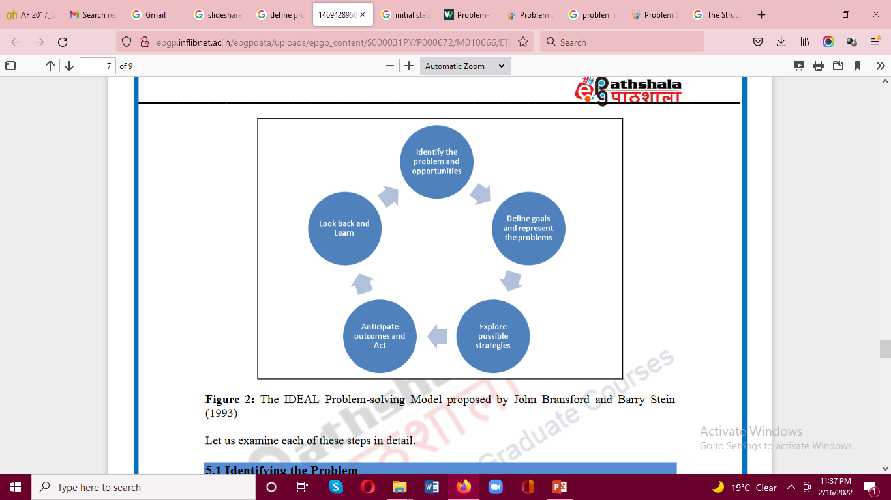
I - Identify it (What is the problem? What decision needs to be made?)
D - Define it (Why is this a problem? What is the desired outcome?)
E - Explore solutions (How can you solve it?)
A - Action (Execute the chosen strategy!)
L - Look back (What did you learn? Was it effective? What could you change?)

Slide 51
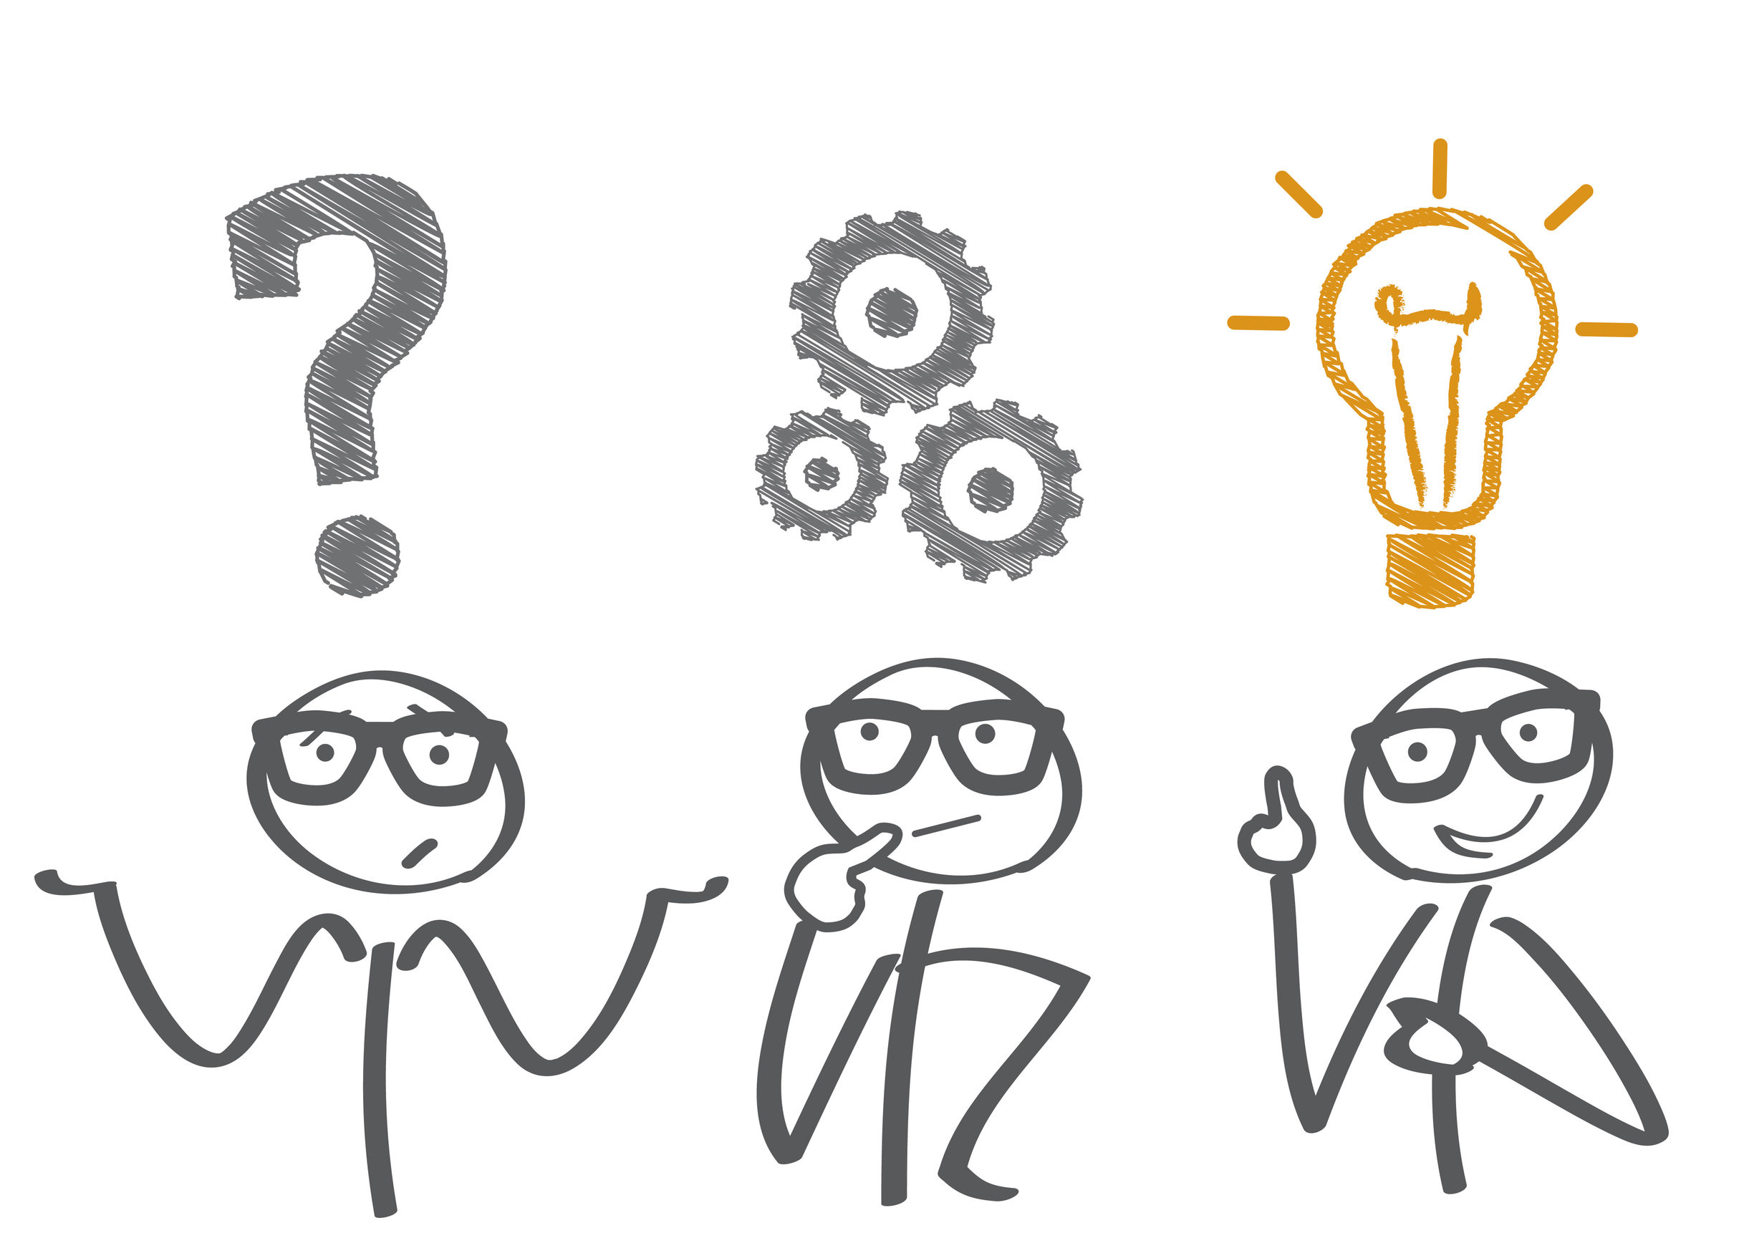
Jovan has been laid off due to COVID-19 and needs to ensure he still has an income.
1. Identify The Problem
Ask yourself what it is that needs to be solved or accomplished.
Can it be fixed or improved?
Consider Jovan scenario. His problem is real and he needs to address his income loss due to being laid off.

Slide 52

2. Define The Problem
This step is similar to Identifying the problem, but seeks to explain why it's a problem.
What is at stake?
How will you be affected?
What would you like to accomplish?
What is in the way?
Back to Jovan scenario, he identified a problem after losing his job due to COVID-19.
This is a problem because:
He needs money to survive. He needs to pay rent, buy food, and other essentials.
There aren't as many alternative job opportunities because of COVID-19.
He is still young and doesn't have a lot of savings.

Slide 53

3. Explore Possible Solutions
Brainstorm possible solutions by:
Making a list.
Drawing a mind-map.
Researching options online.
Jovan could:
Explore government funding available in his country for people affected by COVID-19.
Determine his non-essential expenses.
Ask his family for support.
Find supportive outlets that offer food and essentials to people in need.
Look for a new job, considering all options such as working from home/part-time.

Slide 54

4. Act On The Decided Solution
After weighing the pros and cons of each potential solution, choose the best strategy to execute.
In Jovan scenario, he would likely benefit from more than one potential solution.
He doesn't want to rely on family support until he has tried other options, and could first:
Apply for any government assistance programs he is eligible for.
Apply to new job postings even if there aren't as many options available.
Stop spending money on things that aren't essential

Slide 55

5. Look Back
Evaluate your strategy:
Did it work?
Did you achieve the desired outcome?
Is there still a problem?
Could you improve your strategy?
Jovan has applied for government assistance and new job opportunities.
If he is able to supplement his previous income sufficiently his strategy would be successful. If not, he might need to return to the "explore" step and consider alternatives.

Slide 56
Thankyou!!!

